Slide 1
Capital Bikeshare Demand Forecasting
Nitish Ghosal | Maggie Ledbetter | Adrian Valles

Slide 2
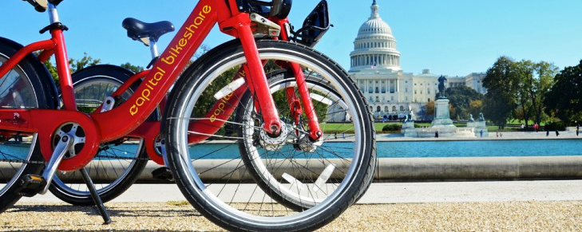



S
Objectives
Supervised learning
Predict bike rental demand given weather conditions and day of week/time of day
Predict future bikeshare usage based on time-based patterns of historical usage.
Time Series analysis

Slide 3

Supervised Learning: Methodology
For prediction of bike demand we used the following supervised learning algorithms:
General linear modeling with LASSO variable selection
Regression tree modeling, Bagging, Random Forest, and Boosting
Generalized additive modeling
We then used in and out of sample mean squared error to compare model performance.

Slide 4
Supervised Learning: Key Findings
Predictive power(mspe) Random forest and Boosting
Interpretability Regression tree
Notes:
Based on MSE and MSPE comparison, we concluded that Random forest and boosting resulted in the best predictive models.
In case we are looking for interpretability, Regression Tree can be a good option although its predictive power is lower than the previous two… we will therefore focus on Regression Tree, random forest and boosting results for this presentation.

Slide 5
Supervised Learning: Key Findings
Further, we consistently saw across models that hour was the strongest predictor. Temperature and Humidity were also consistently a key predictor along with season, while holiday was much less predictive across models.
Year was also highly predictive across models, with demand higher in 2012 than 2011, suggesting an increase in bikeshare popularity year over year.

Slide 6
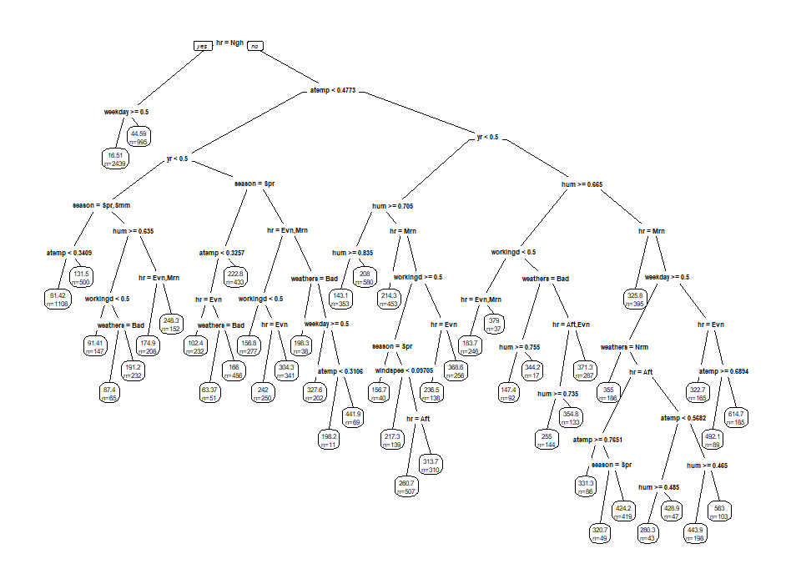
Supervised Learning: Regression Tree Model
Our initial regression tree was very large, which could result in overfitting and low out of sample prediction rate.

Slide 7
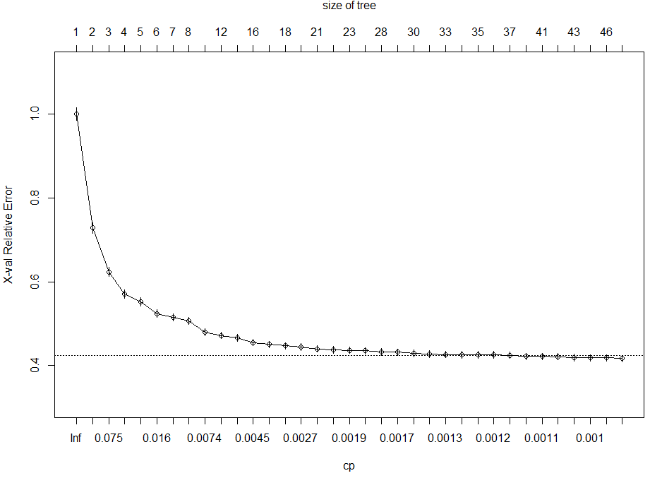
Supervised Learning: Regression Tree Model
While cp score vs. relative error suggests we should have chosen a larger tree with up to 30 splits, we ultimately decided to use a tree with 10 to avoid unnecessary model complexity.

Slide 8
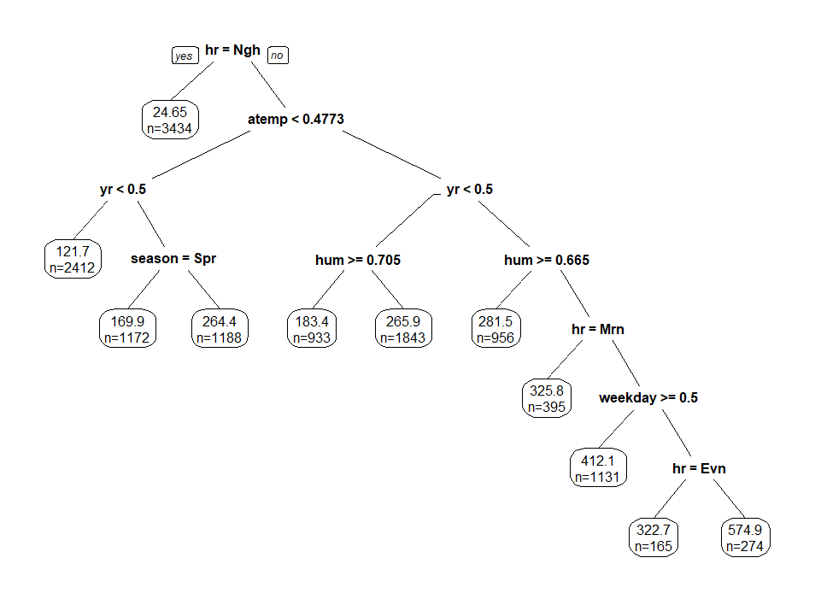
Supervised Learning: Regression Tree Model
Our smaller final tree still resulted in strong MSE and MSPE scores: 15,534.63 and 16,778.2, respectively.

Slide 9
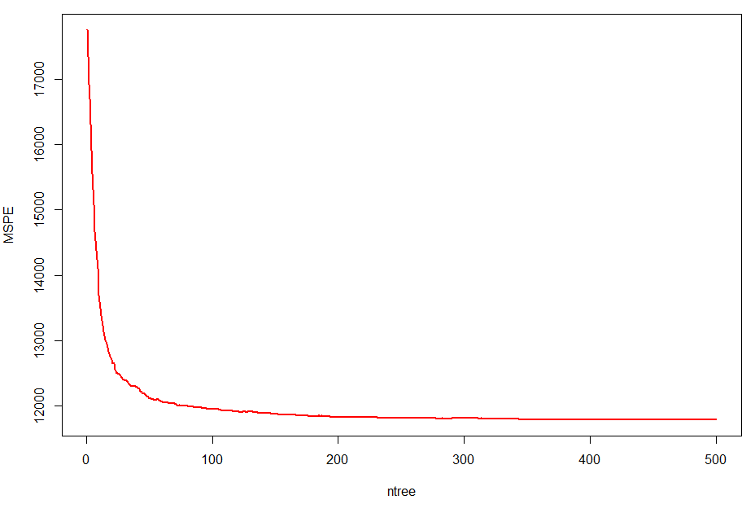
Supervised Learning: Random forest
60% reduction in MSE and 25% in MSPE with respect to the regression tree
.

Slide 10
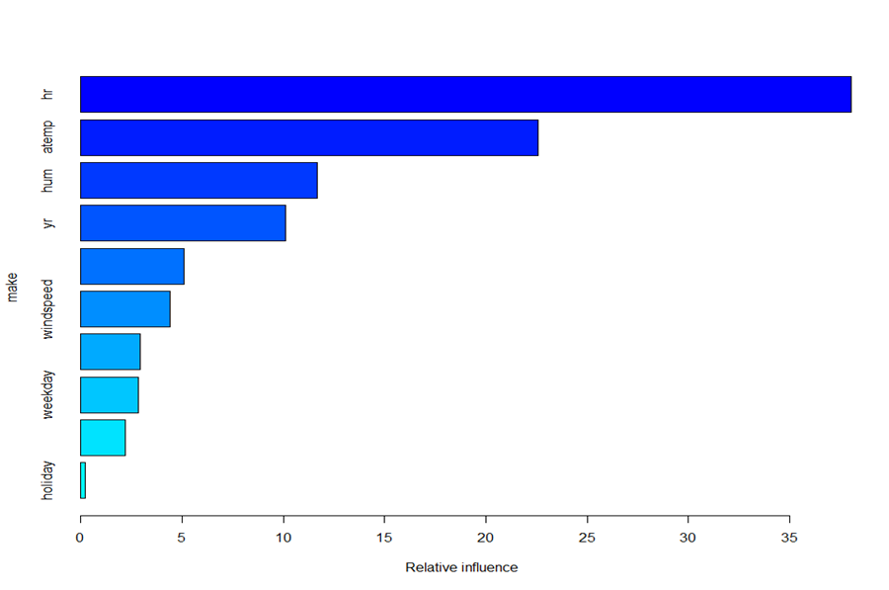
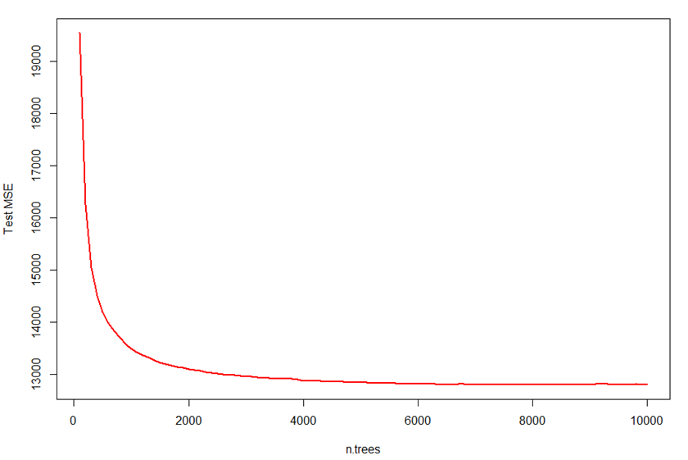
Supervised Learning: Boosting
Similar MSPE than random forest but slightly worse MSE
Conclusion: Use R.F as it is less computational expensive

Slide 11
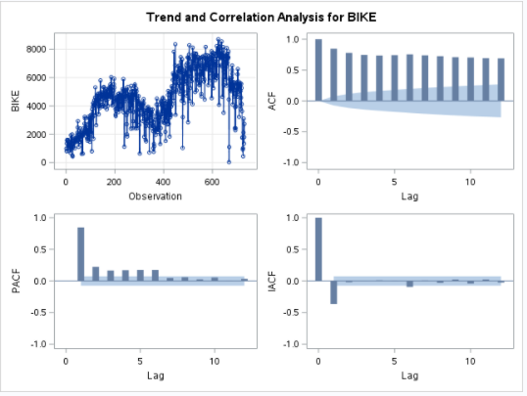
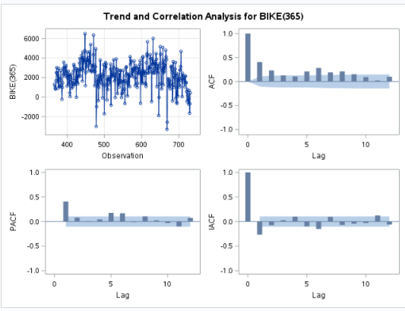
Time Series Analysis: Methodology
To forecast daily bike demand for the next year, we employed univariate time series analysis in SAS.
Initial Daily Bike Demand
First Order Difference
Notes:
Explain the seasonal pattern of the data…that’s why we are taking order difference with seasonality…
When the series has a seasonal pattern, you might want to difference the series at a lag that corresponds to the length of the seasonal cycle. For example, if Bike demand is a daily series, we take first order difference at a lag of 365

Slide 12
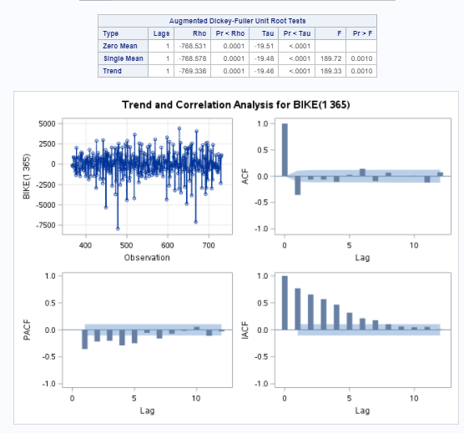
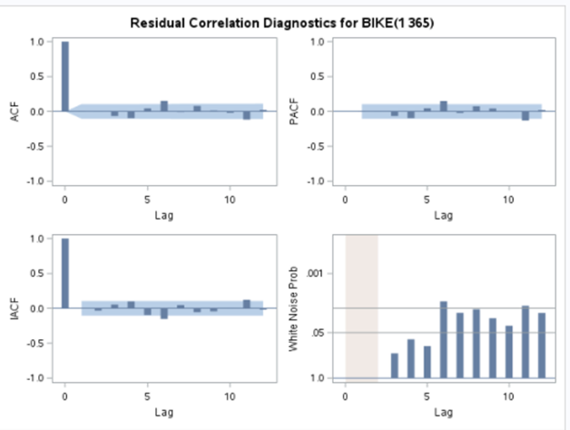
Time Series Analysis: Methodology
Second order difference
Stationary
ARIMA (1,2,1)
Right model

Slide 13
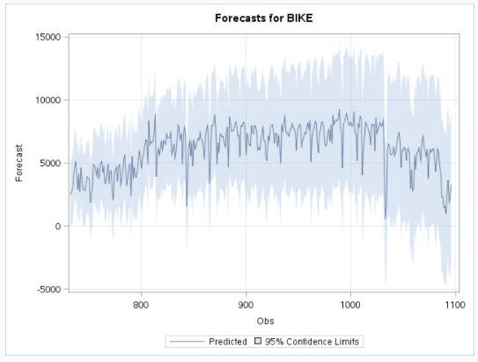
Time Series Analysis: Key Findings
Based on model comparison using ACF and PACF, we concluded at the ARIMA(1,2,1) model was appropriate with estimates for MA(1)=0.91 and AR(1)=0.26.

Slide 14
S
Conclusions
Supervised
Random forest is the most effective algorithm for prediction; time of day is the single most important variable
Time Series
ARIMA(1,2,1) model with second degree difference is most appropriate for predicting 2013 daily bike demand

